Slide 1
差错检测与纠错

Slide 2
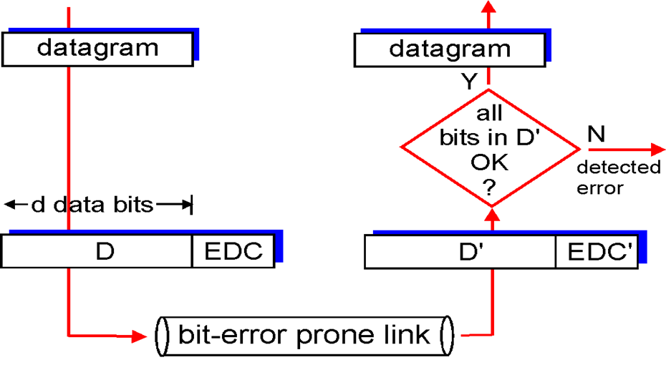
Error Detection
EDC = Error Detection and Correction bits (redundancy)
D = Data protected by error checking, may include header fields
Error detection not 100% reliable!
protocol may miss some errors, but rarely
larger EDC field yields better detection and correction

Slide 3
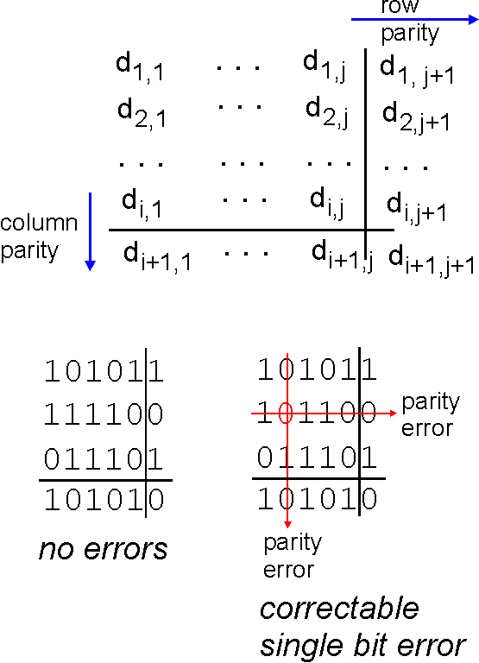
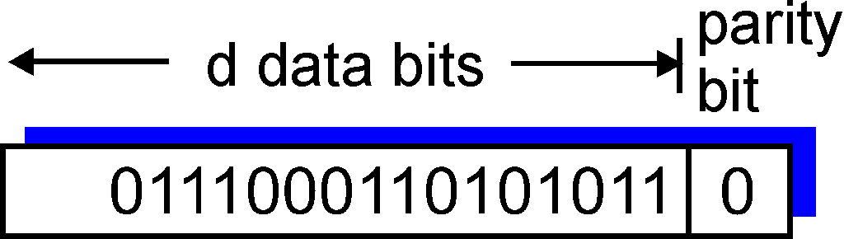
Parity Checking
Two Dimensional Bit Parity:
Detect and correct single bit errors
Single Bit Parity:
Detect single bit errors

Slide 4
Internet checksum (review)
Goal: detect “errors” (e.g., flipped bits) in transmitted packet (note: used at transport layer only)
Sender:
treat segment contents as sequence of 16-bit integers
checksum: addition (1’s complement sum) of segment contents
sender puts checksum value into UDP checksum field
Receiver:
compute checksum of received segment
check if computed checksum equals checksum field value:
NO - error detected
YES - no error detected. But maybe errors nonetheless?

Slide 5
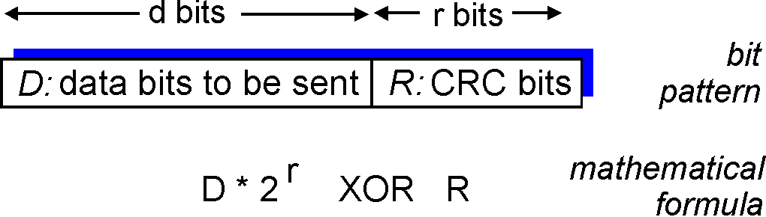
Checksumming: Cyclic Redundancy Check
view data bits, D, as a binary number
choose r+1 bit pattern (generator), G
goal: choose r CRC bits, R, such that
<D,R> exactly divisible by G (modulo 2)
receiver knows G, divides <D,R> by G. If non-zero remainder: error detected!
can detect all burst errors less than r+1 bits
widely used in practice (Ethernet, 802.11 WiFi, ATM)

Slide 6
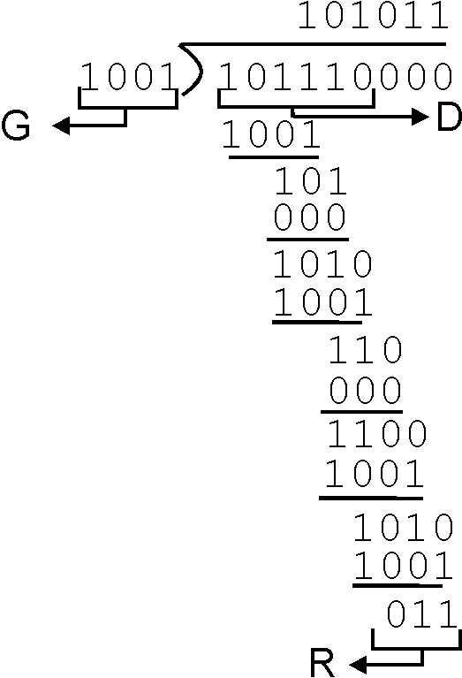
CRC Example
Want:
D.2^{r} XOR R = nG
equivalently:
D.2^{r} = nG XOR R
equivalently:
if we divide D.2^{r} by G, want remainder R
D.2^{r}
G
R = remainder[ ]

Slide 7

Summary
Parity Checking
CRC

